Slide 1


Flood-Guard
Predicts Flood Possibilities in Bangladesh
Presented By:
1. MD Fahad Sikder
ID: CSE 029 07725
2. Sharmin Akter
ID: CSE 02907717
Supervised By:
Mrs. Manoara Begum
Chairman
Dept. of CSE
Port City International University
3. Sabikun Newaz Chy
ID:CSE 029 07726
4. Sakil Uddin
ID: CSE 029 07744

Slide 2
Contents
Introduction & Motivation
Problem Statement
Objectives
Literature Review
Methodology
Dataset
System Requirements
Pre Processing
Results & Discussion
Result Summary
Comparison Analysis
Conclusion
References

Slide 3
Introduction & Motivation
Context
Problem
Bangladesh is a climate-vulnerable nation facing annual flooding disasters.
Traditional forecasting often fails to capture non-linear climate shifts.
Motivation
Goal
We need an automated, data-driven system to predict exact rainfall amounts for early disaster preparedness.
Bridge the gap between historical patterns and modern anomalies using ML.

Slide 4
Problem Statement
Current Issue
The Gap
The Challenge
Existing flood warnings rely on static thresholds or expensive physical simulations.
Few systems use a "Consensus Approach" combining traditional ML stability with Deep Learning sensitivity.
Accurately forecasting monthly rainfall and temperature using limited historical features (Month/Year) from 1901–2020.

Slide 5
Objectives
01
02
03
Primary
Secondary
Final Goal
Develop a model to forecast Rainfall (mm) and Temperature (°C) with >80% accuracy.
Implement and compare Random Forest (ML) vs. Artificial Neural Networks (DL).
Create a "Flood Risk Alert" system triggering at the 300mm danger threshold.

Slide 6

Literature Review
No | Title | Author | Publisher & Year | Key Contribution | Dataset
1 | Prediction of Rainfall in Bangladesh | Mahfuz Ahmed Azmain et al. | IEEE (2022) | Random Forest achieved strong baseline performance with 91% accuracy for regional rainfall prediction. | Bangladesh Regional Rainfall Data
2 | Flood Prediction in Bangladesh Using Machine Learning and Explainable AI | Refat Ishrak Hemel, Sadman Sakib | IEEE (2024) | Demonstrated the importance of explainable models to interpret flood prediction decisions. | Meteorological & Hydrological Data
3 | Relations of Water-logging with Heavy Rainfall in Dhaka City (1991-2021) | Mohammad Nazrul Islam | JETIR (2022) | Identified 300 mm monthly rainfall as a critical threshold causing urban flooding. | Dhaka Urban Rainfall Data

Slide 7


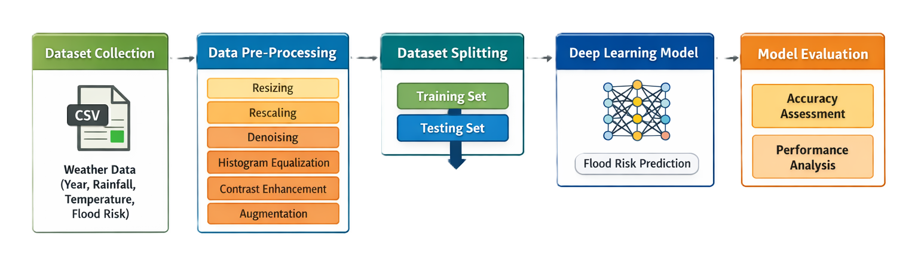



Methodology Overview
Step 1
Data Collection (BMD Archives 1901-2020).
Step 2
Preprocessing (Scaling & Cleaning).
Step 3
Data Splitting for Training and Testing
Step 4
Fig 1: Architecture
Model Training (Model A: Random Forest, Model B: ANN).
Step 5
Model Evaluation

Slide 8
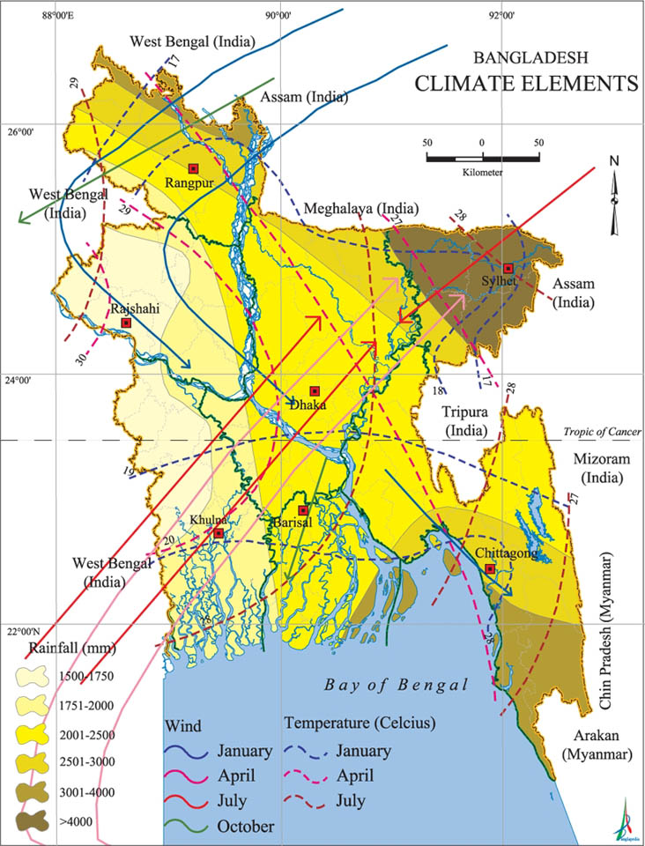
The Dataset
Source: Bangladesh Meteorological Department (BMD) Archives, through Kaggle.
Volume: ~1,474 Monthly Records (1901–2020).
Inputs (Features): Month (Seasonality), Year (Long-term trends).
Outputs (Targets): Rainfall (mm), Temperature (°C).
Fig 2: Bangladesh Weather Map

Slide 9




System Requirements
Hardware
Software
Libraries
AMD Ryzen 5 3500, 16GB RAM
Python 3.10+, Google Colab Environment.
Scikit-Learn (ML), TensorFlow/Keras (Deep Learning), Pandas, Matplotlib.

Slide 10
Data Pre-Processing
Cleaning
Renamed columns (tem -> Temperature, rain -> Rainfall). Verified zero null values.
Scaling
Applied StandardScaler to normalize inputs (Crucial for Neural Network performance).
Splitting
80% Training Data, 20% Testing Data.

Slide 11
Result & Discussion
Accuracy Results
Metric:
Random Forest:
R² Score (Coefficient of Determination).
~76% Accuracy (Rainfall), ~96% (Temp).
Neural Network:
Verdict:
~82% Accuracy (Rainfall), ~96% (Temp).
Both models are reliable, with ANN showing a slight edge in capturing rainfall complexity.

Slide 12
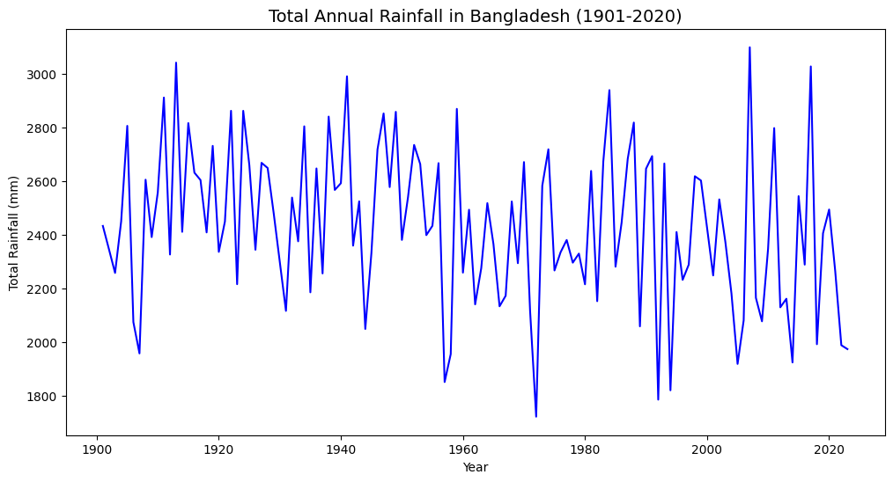
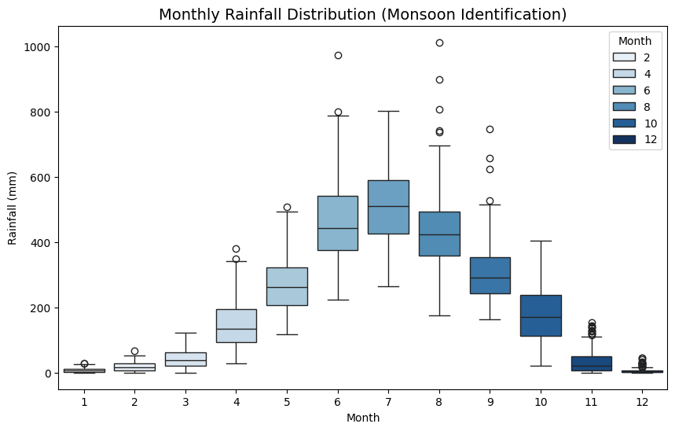
Result Summary
Fig 3: Total Rainfall in Bangladesh (1901-2020)
Fig 4: Monthly Rain Distribution

Slide 13
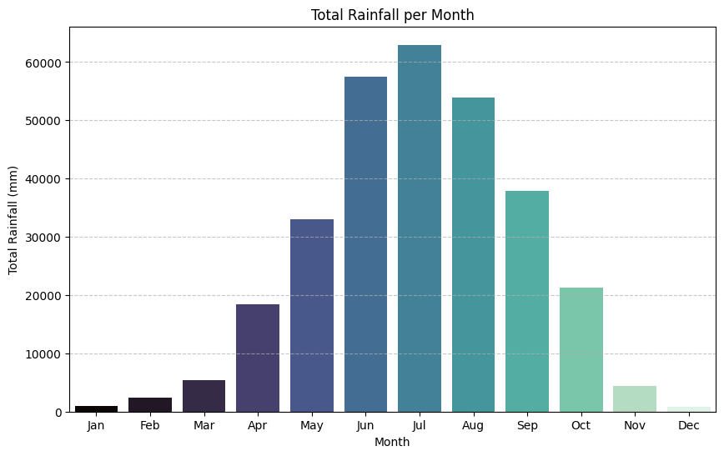
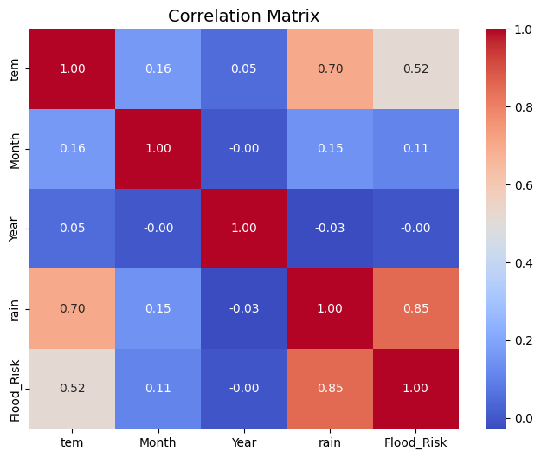
Result Summary
Fig 5: Total Rainfall per Month in Bangladesh
Fig 6: Correlation Matrix

Slide 14
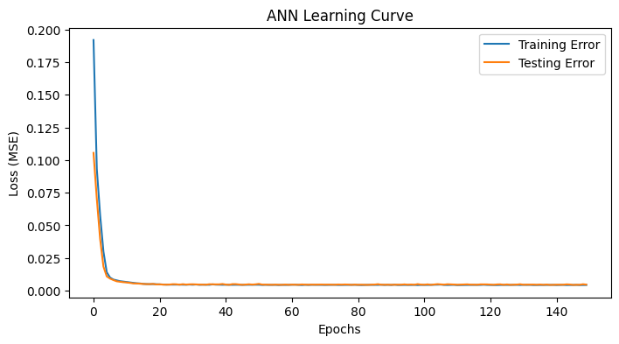
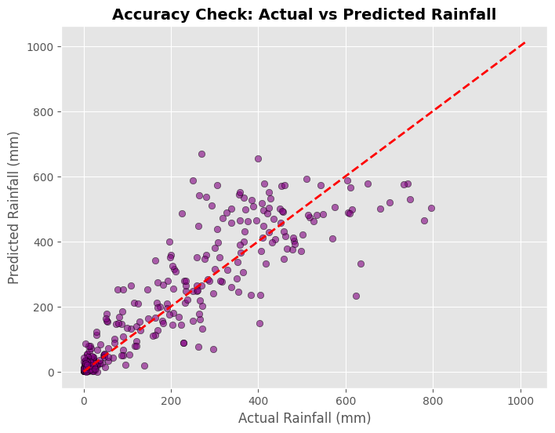
Result Summary
Fig 7: ANN Leaning Curve
Fig 8: Accuracy Check

Slide 15
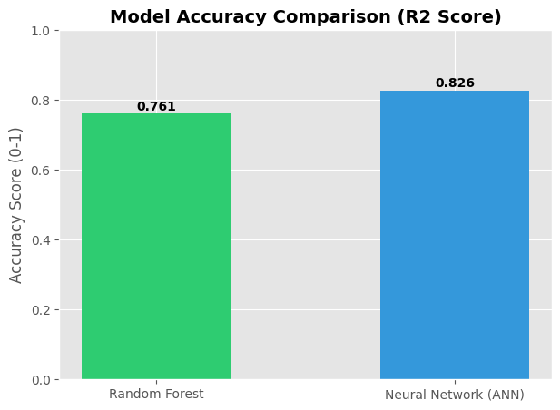
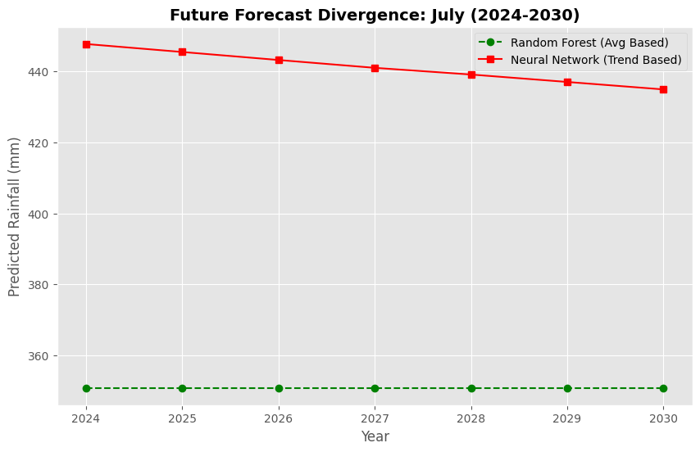
Result Summary
Fig 9: Accuracy Comparison (RF vs ANN)
Fig 10: Future Forecast Divergance

Slide 16
Comparative Analysis
Divergence:
Interpretation:
For July 2031, RF predicted 350.85 mm, while
ANN predicted 410.07 mm.
RF relies on 100-year averages. ANN detected a recent drying trend in the specific month.
We present both numbers to offer a "Best Case" vs. "Worst Case" scenario to policymakers.

Slide 17



Conclusion
Success:
Impact:
Innovation:
Developed "Flood-Guard," a functional dual-engine AI system.
Proves Machine Learning is viable for long-term forecasting in Bangladesh.
Mitigated individual model weaknesses by combining ML and DL architectures.

Slide 18
References
[1] M. A. Azmain, M. Ahmed, et al., “Prediction of rainfall in Bangladesh using machine learning techniques,” IEEE, 2022.
[2] R. I. Hemel and S. Sakib, “Flood prediction in Bangladesh using machine learning and explainable artificial intelligence,” IEEE, 2024.
[3] M. N. Islam, “Relations of water-logging with heavy rainfall in Dhaka city (1991–2021),” Journal of Emerging Technologies and Innovative Research (JETIR), vol. 9, no. 6, 2022.
[4] OpenAI, “ChatGPT: Optimizing language models for dialogue,” OpenAI Technical Report, 2022. [Online]. Available: https://openai.com
[5] Google DeepMind, “Gemini: A family of highly capable multimodal AI models,” Technical Report, 2023. [Online]. Available: https://deepmind.google

